Slide 1
GOLF FITNESS AND INJURIES

Slide 2
Golf & Fitness
Fitness is crucial
Golf fitness is about being in “good shape”
Strength, flexibility and overall fitness play a critical role in the game
Able to play without getting tired or loosing concentration
Being flexible enough to make a complete shoulder turn
Being able to swing the club without pain

Slide 3
Reasons to Start a Fitness Program
Golf fitness helps
  you hit it longer
  helps you hit more solid shots
  helps protect you from injury
  helps you play longer
  helps you perform at your peak
  helps save your joints
  helps you concentrate and focus better
  helps protect your back
  helps combat chronic diseases
  helps you sleep better
  https://www.youtube.com/watch?v=AvuD4hsvw9c
  https://www.youtube.com/watch?v=ZveRbRXHL1g

Slide 4
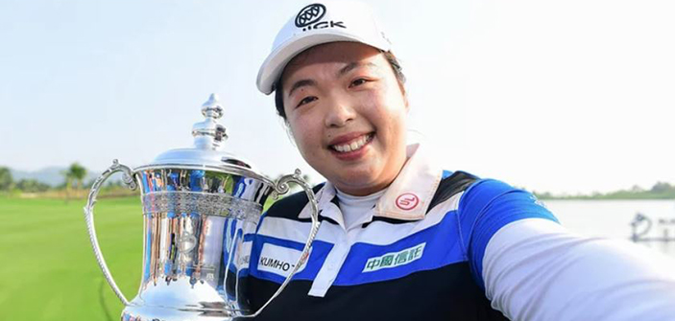
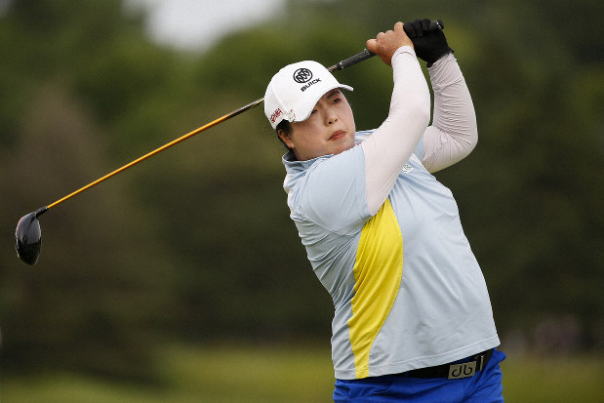
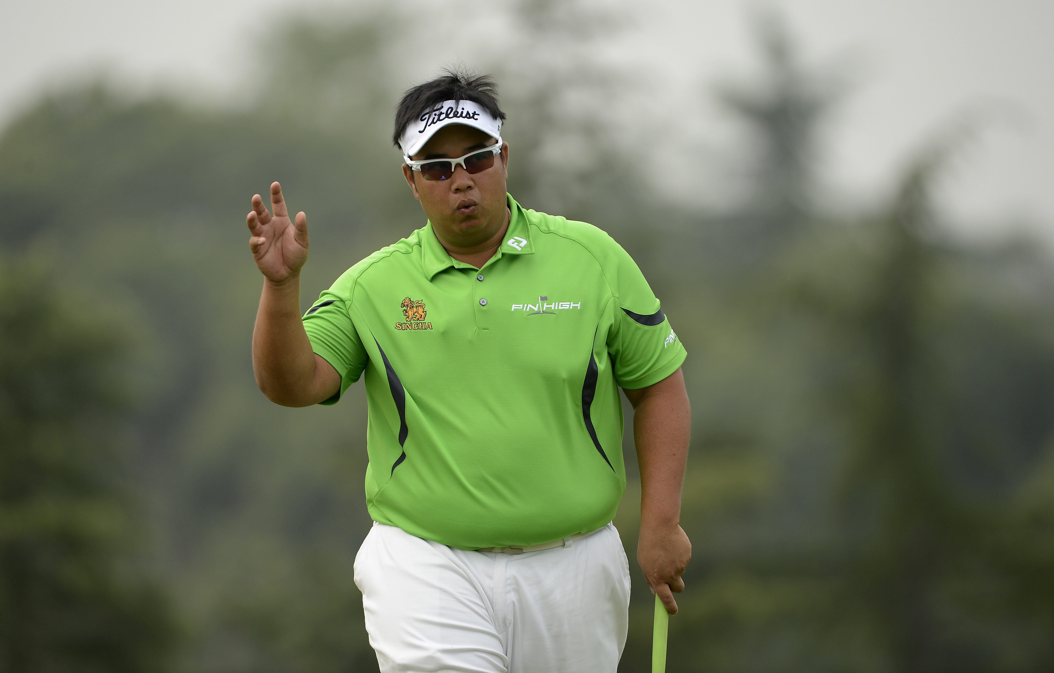

Shanshan Feng
Kiradech Aphibarnrat

Slide 5
Warm-Up
The process of increasing muscle temperature, which in turn increases blood flow to bring oxygen to the muscles and joints
Helps loosen stiff muscles and joints, making it easier to swing the clubs efficiently
Should include motions using specific muscles utilized in the golf swing
The key to better play and minimizing risk of injury
  Warming up is the easiest and most effective way to prevent injuries

Slide 6
A Golf Specific Warm Up
Prepares golf specific muscles to move more efficiently
Increases blood flow to loosen and relax stiff muscles
Increases energy / elevates energy level
Reduces the chance of injury
Increases physical capacity
Raises resistance to fatigue
Improves mental awareness and cognitive function
Decreases anxiety
Enhance performance
https://www.youtube.com/watch?v=youdNxdeOpc

Slide 7
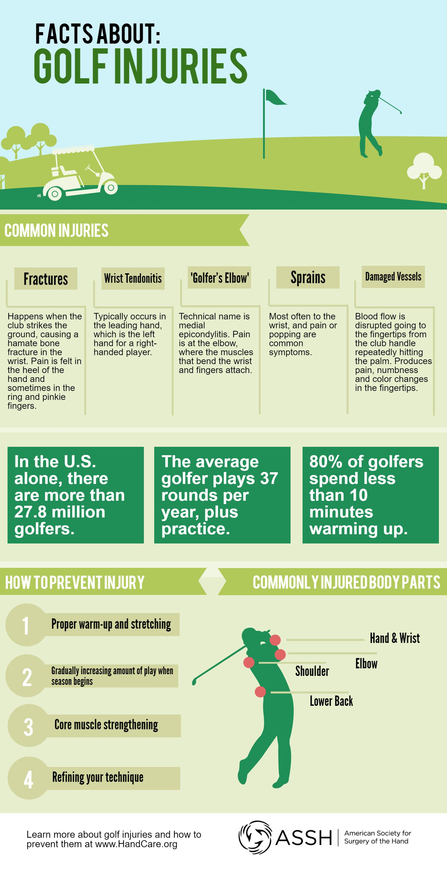

Slide 8
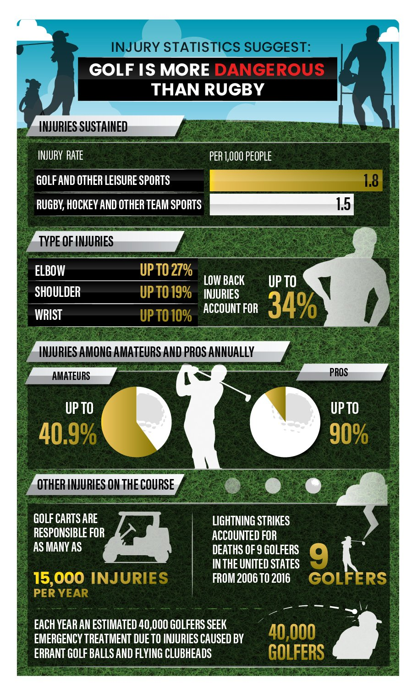

Slide 9
Injury Awareness
10 most common golf injuries
  Back pain https://www.youtube.com/watch?v=o2VsM5zg65I
  Tendonitis in the elbows
  Knee pain
  Rotator cuff injuries
  Wrist injuries
  Hand and finger injuries
  Neck injuries
  Foot and ankle injuries
  Hip injuries
  Sunburn

Slide 10
Factors that contribute to common golf swing injuries
Overuse & too much practice
Poor swing mechanics
Tendency to over-swing
Failure to warm up muscles before play
Rotational stress placed on the spine
Incorrect grip and setup
Traumatic force to the body resulting from poorly executed swing
https://www.youtube.com/watch?v=08VECvZb8o4

