Slide 1
THE HISTORY OF GOLF

Slide 2
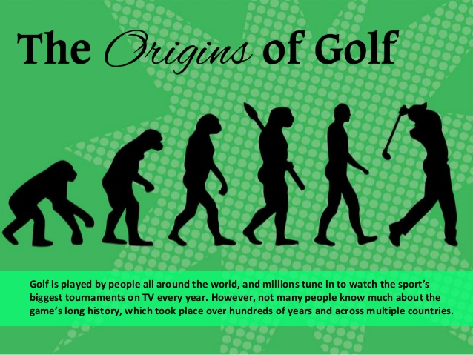

Slide 3



Slide 4
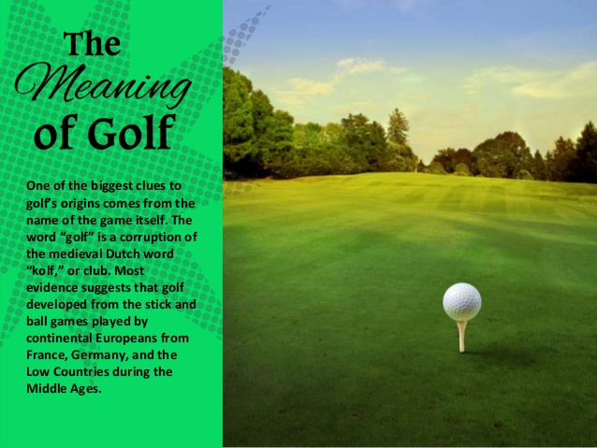

Slide 5
The Meaning Of Golf
the game's ancient origins are unclear and much debated.
Some historians^{[3]} trace the sport back to the Roman game of paganica, in which participants used a bent stick to hit a stuffed leather ball. One theory asserts that paganica spread throughout Europe as the Romans conquered most of the continent, during the first century BC, and eventually evolved into the modern game.^{[4]}
Others cite chuiwan (捶丸; "chui" means striking and "wan" means small ball)^{[5]} as the progenitor, a Chinese game played between the eighth and fourteenth centuries.^{[6]} A Ming Dynasty scroll by the artist Youqiu dating back to 1368 entitled "The Autumn Banquet" shows a member of the Chinese Imperial court swinging what appears to be a golf club at a small ball with the aim of sinking it into a hole.^{[5]} The game is thought to have been introduced into Europe during the Middle Ages.^{[7]}

Slide 6
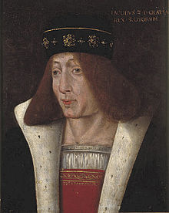


Slide 7
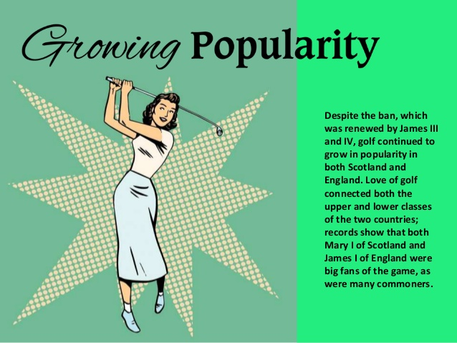
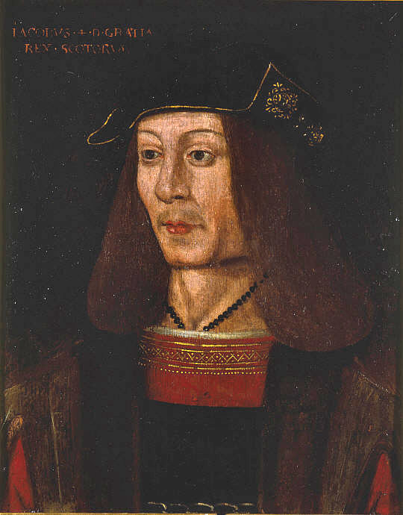

Slide 8
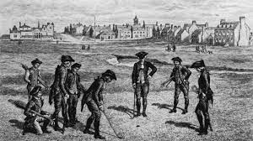
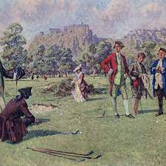

Slide 9
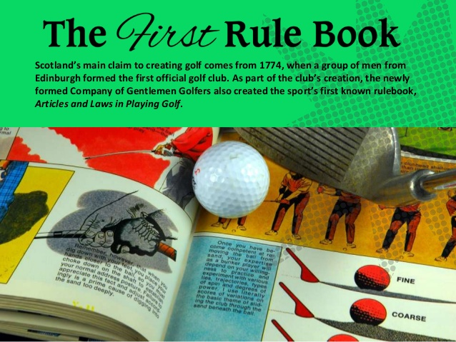
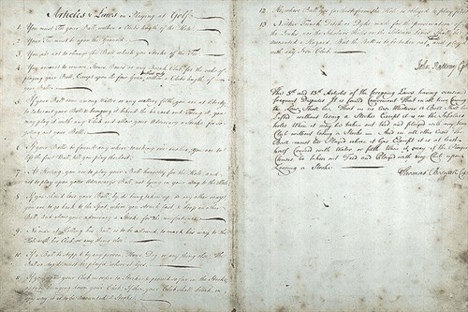

Slide 10
New Era Of Golf
In 1764, the standard 18-hole golf course was created at St Andrews when members modified the course from 22 to 18 holes.^{[11]} Golf is documented as being played on Musselburgh Links, East Lothian, Scotland as early as 2 March 1672, which is certified as the oldest golf course in the world by Guinness World Records
https://www.youtube.com/watch?v=LGtxEaOXzHI

Slide 11
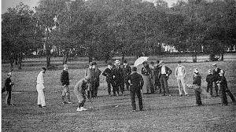
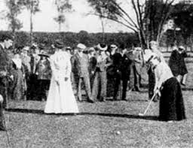

Slide 12


Slide 13


Slide 14
History of
Golf in Malaysia

Slide 15
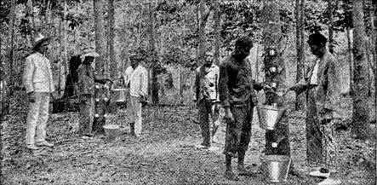
Little is known of the beginnings of golf in this country. It is fairly certain, however, that the game was imported at about the same time as the rubber tree. Golf in Malaysia is, therefore a game of more than respectable antiquity.

Slide 16
Sometime in 1894, at some 19th hole, a few golfers were discussing the respective merits of their favourite players. To settle the issue it was decided to hold an 18-hole stroke play competition open to all comers.
Thus was born the Straits Championship, the forerunner of the Malaysian Open Amateur Championship. Except for the war years 1917-18 and 1941-47 this event has been held annually.
The venue was fixed by mutual agreement between various clubs in Singapore, Kuala Lumpur and Penang and the organization is left to the host club.

Slide 17

It was not until 1929 that a national organization was formed to run the amateur championship in the country. Called the Malayan Golf Association, it progressively undertook the functions of co-ordinating golfing activities in Malaya and Singapore.
By 1953, the Association had 15 member clubs in Kuala Lumpur, Perak, Kedah, Malacca, Penang, Johor, Selangor as well as Singapore. Nine years later in 1962 the Association’s name was change to Federation of Malaya Golf Association after Singapore formed its own national body.

Slide 18
By 1965, however, the two associations teamed up again to form the Golf Association of Malaysia.
However, the alliance was short lived due to territorial divide, which resulted in the separation of Singapore from Malaysia.
In 1965 the Association changed its name to
Malaysian Golf Association – in short called “M.G.A.”

Slide 19
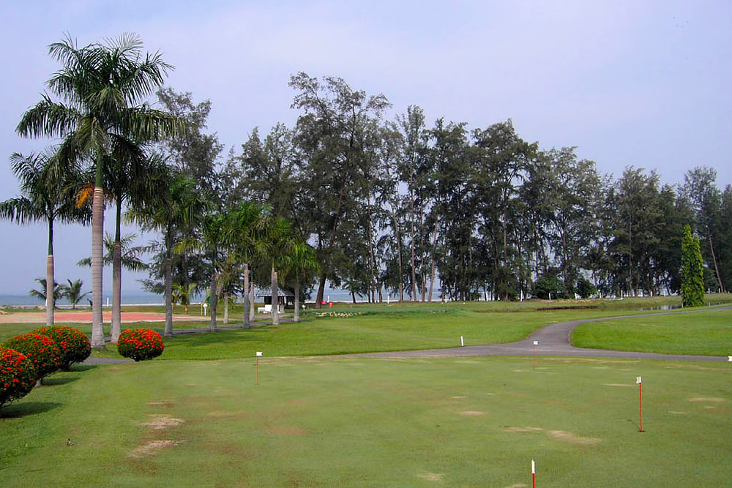
Royal Pahang Golf Club

Slide 20

Forest City, JB

Slide 21

TPC, KL

