Slide 1
Introduction to Golf

Slide 2

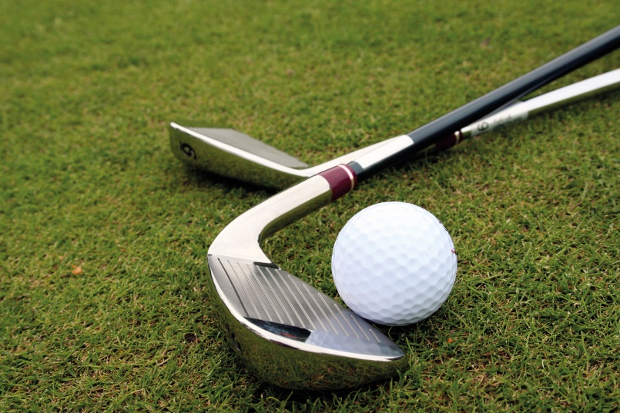
Golf is a game that is played with one ball and a set of metal sticks (known as Clubs) that look somewhat like a weird version of hockey sticks.
Each player plays with his own ball and his own set of clubs (usually 14 in number).
The entire game is played in a fairly large sized ground that has no particular shape and is spread over an area as large as 100-200 acres.

Slide 3
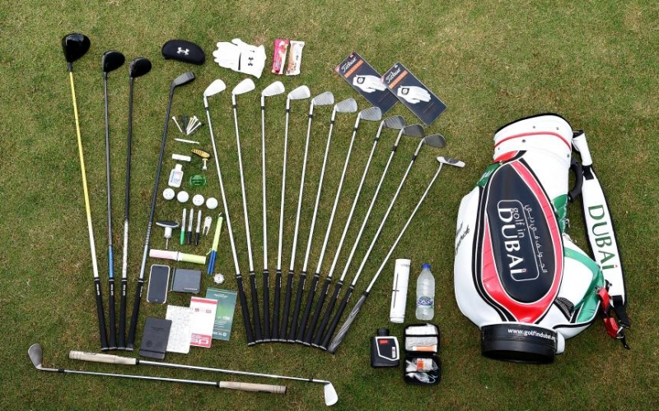
Golf Equipment

Slide 4
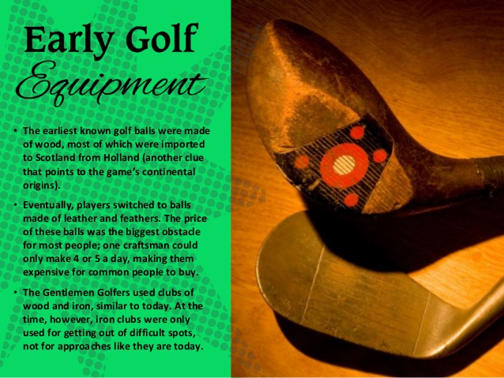

Slide 5

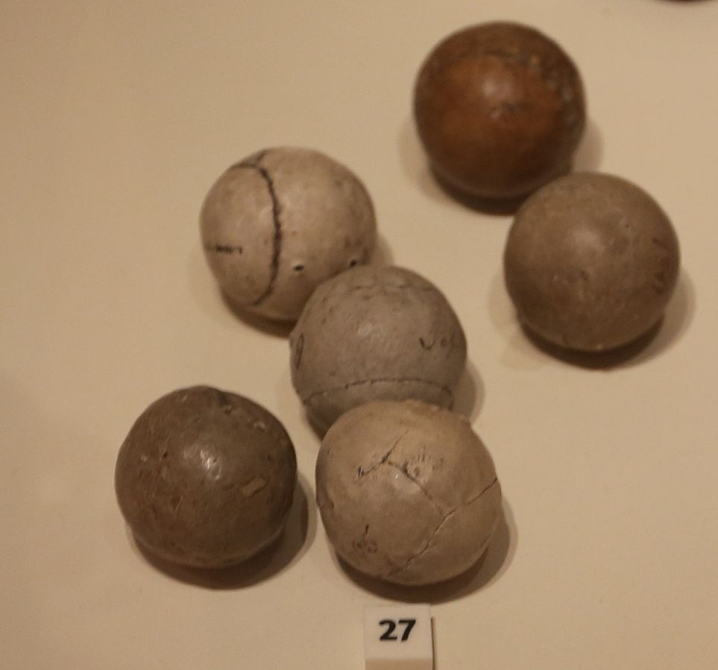
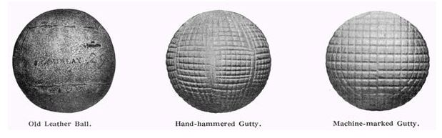
Golf Ball
Mass not more than 45.93 grams
Cannot smaller than 42.67mm
must be spherical and must have a symmetrical arrangement of dimples on its surface
testing and approval by the R&A (formerly part of the Royal and Ancient Golf Club of St Andrews) and the United States Golf Association
Featherie ball
Rev. Dr. Robert Adams Paterson invented the gutta-percha ball

Slide 6

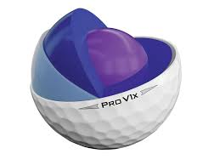
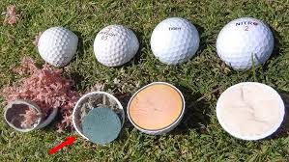
MODERN GOLF BALL

Slide 7
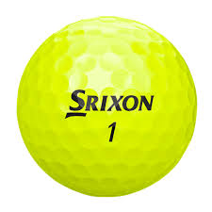
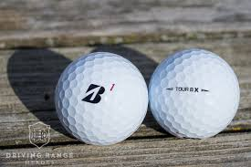
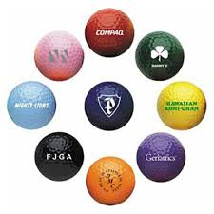
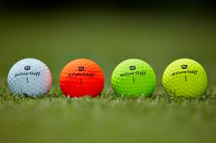

Slide 8
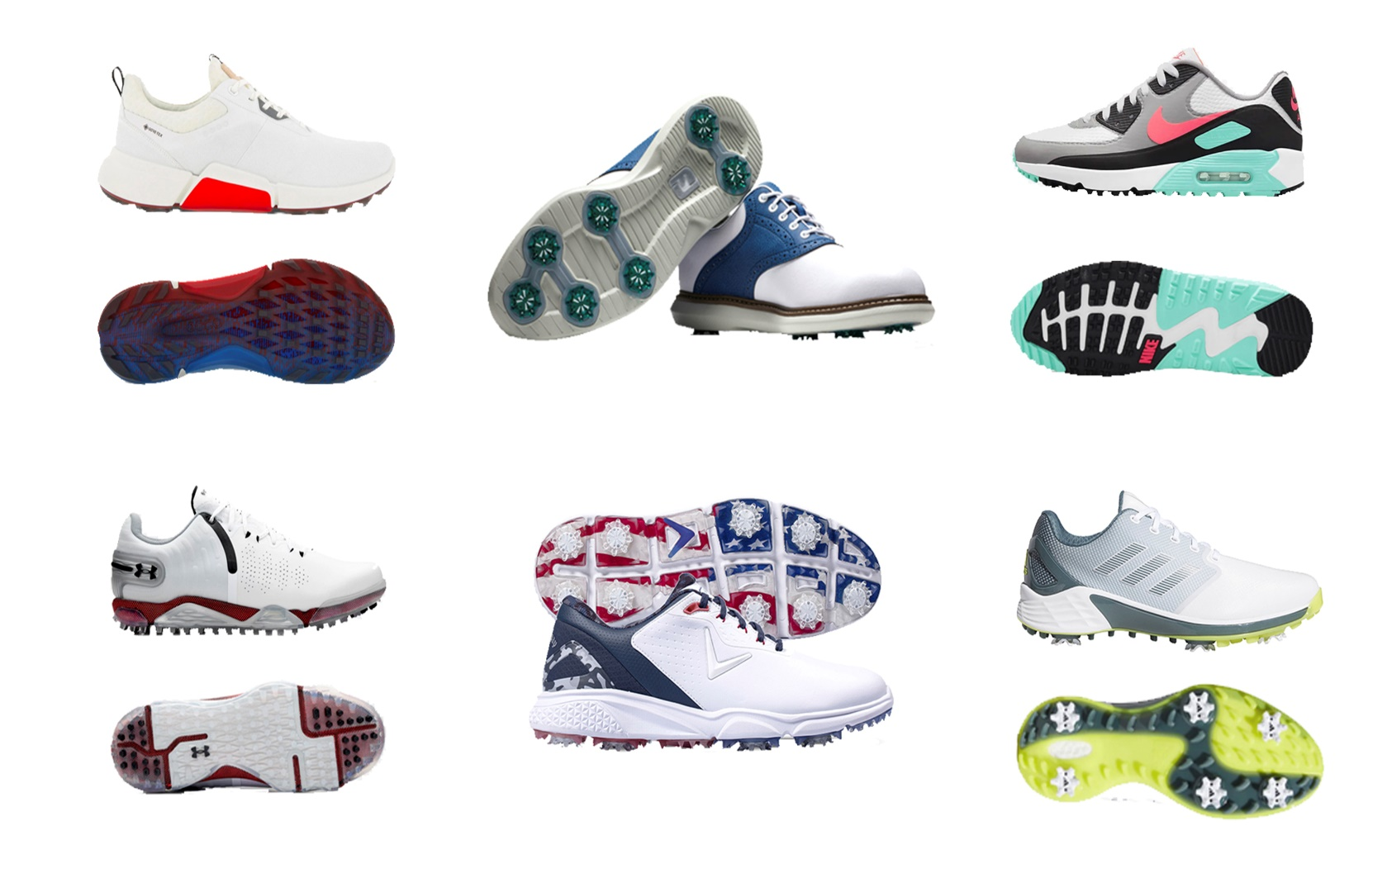
SHOES

Slide 9
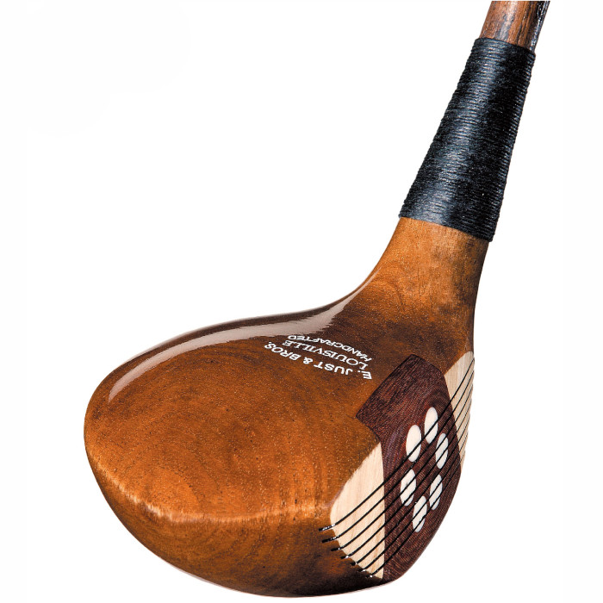
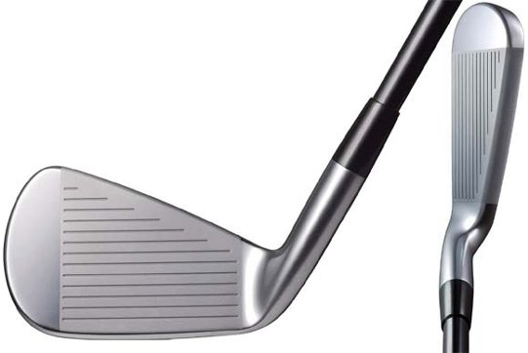
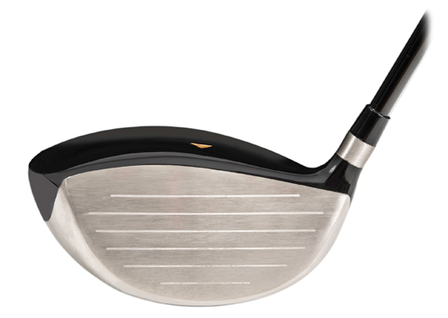
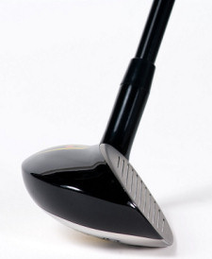
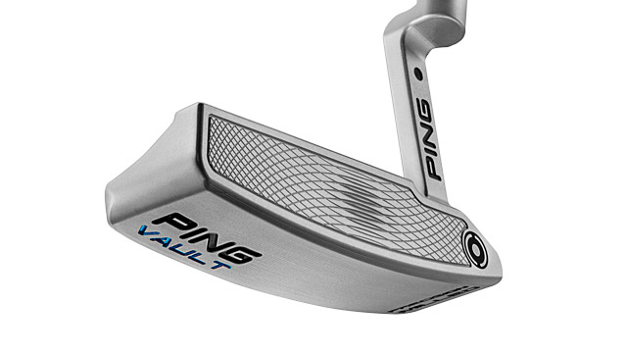
Golf Club
Wood – long distance club
Iron - clubs with a solid, all-metal head
  Wedge - allow for easier use in tricky lies
Hybrid - the wood's long distance and higher launch
Putter - a special class of clubs
  Chipper - more lofted face

Slide 10
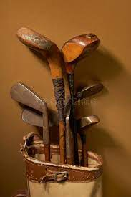
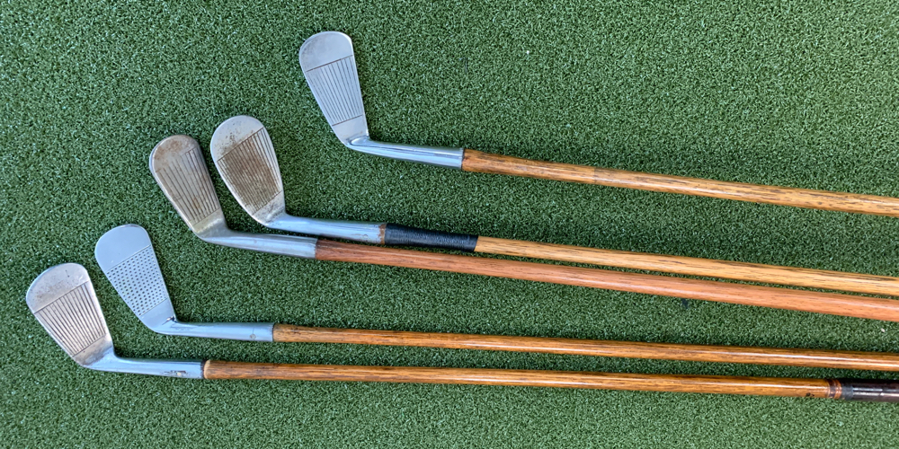
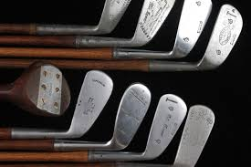

Slide 11
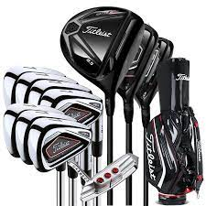
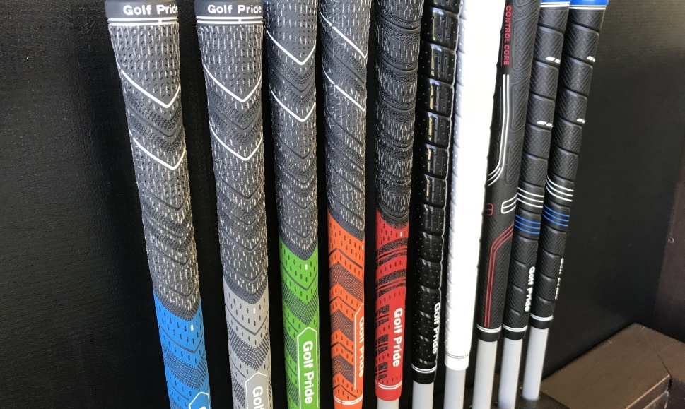
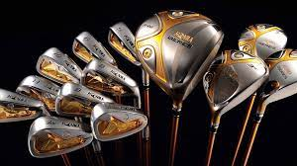
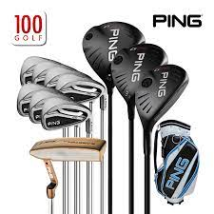

Slide 12
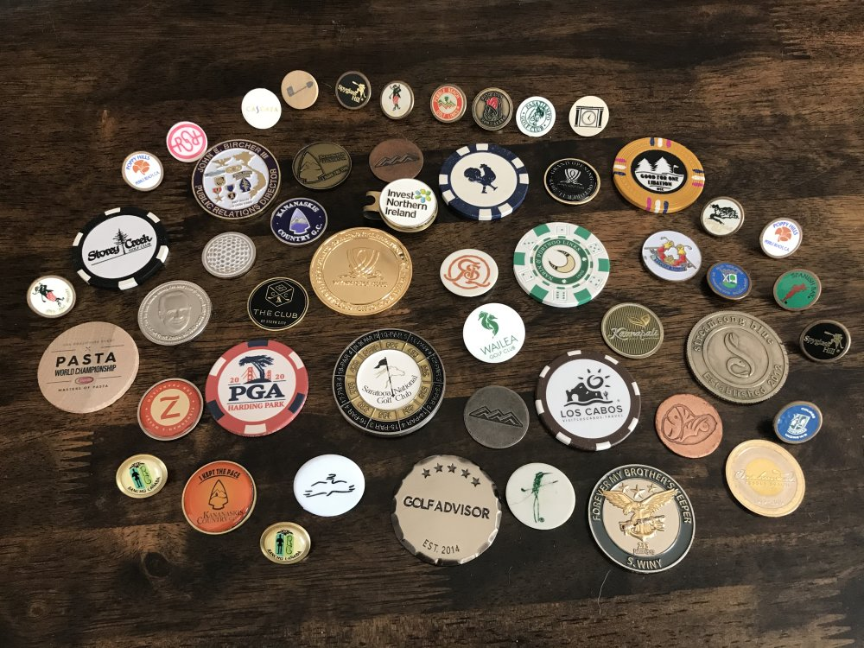
Ball Marker
a round, flat piece of metal or plastic
Replaceable by a small coin such as a penny
used on putting greens to mark the position of a player's ball so that he or she will be able to remove their golf ball to allow another player to putt without obstruction.

Slide 13
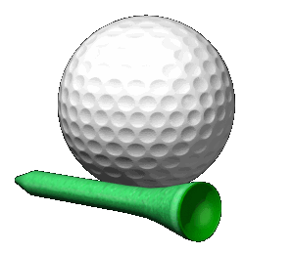
Tee
To support a stationary ball so that the player can strike it
The teeing ground
Tee shot
Local or seasonal rules
5.4 cm long
Wood or durable plastic
Must not longer than 101.6 mm

Slide 14
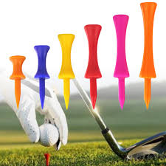
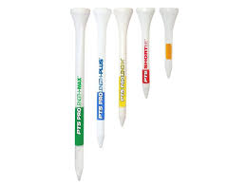
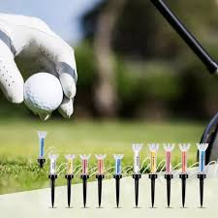
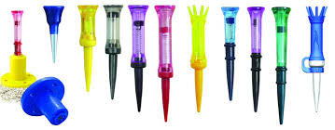

Slide 15
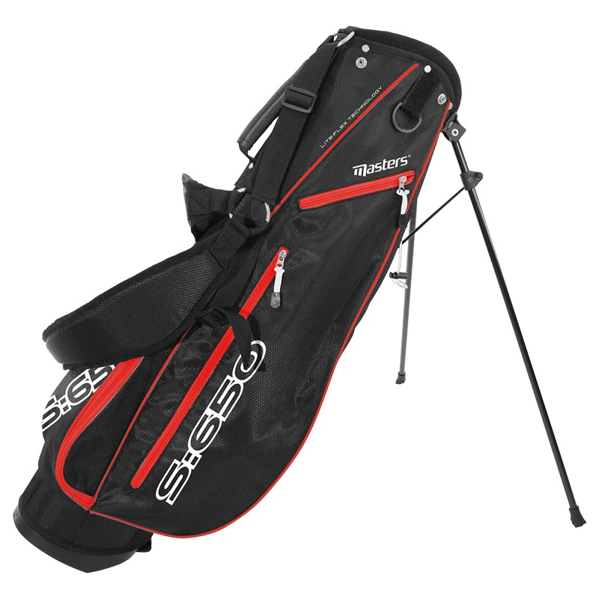
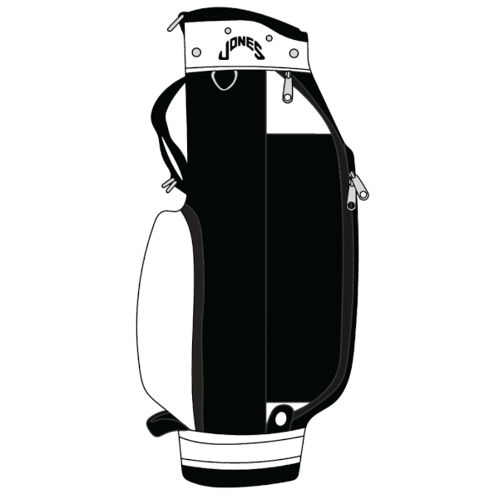
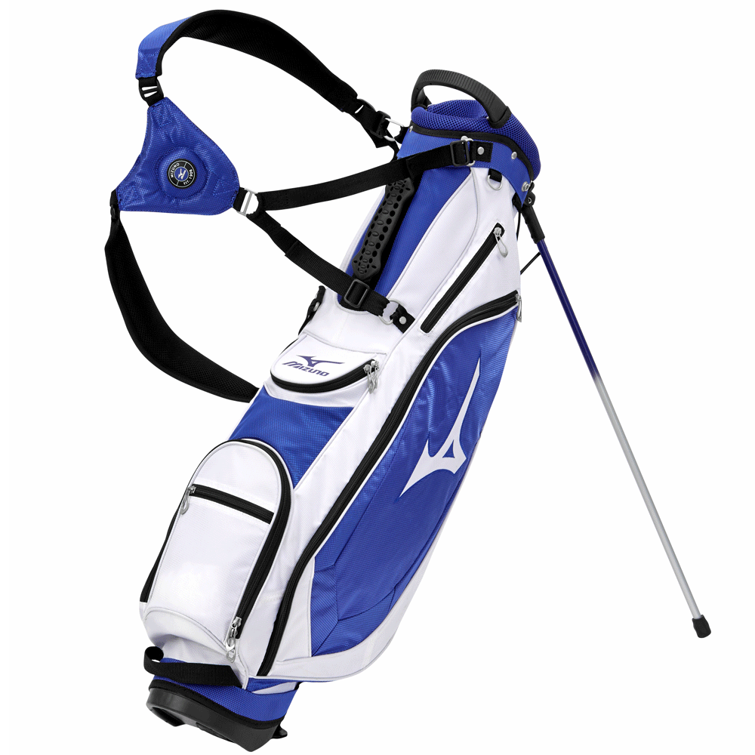
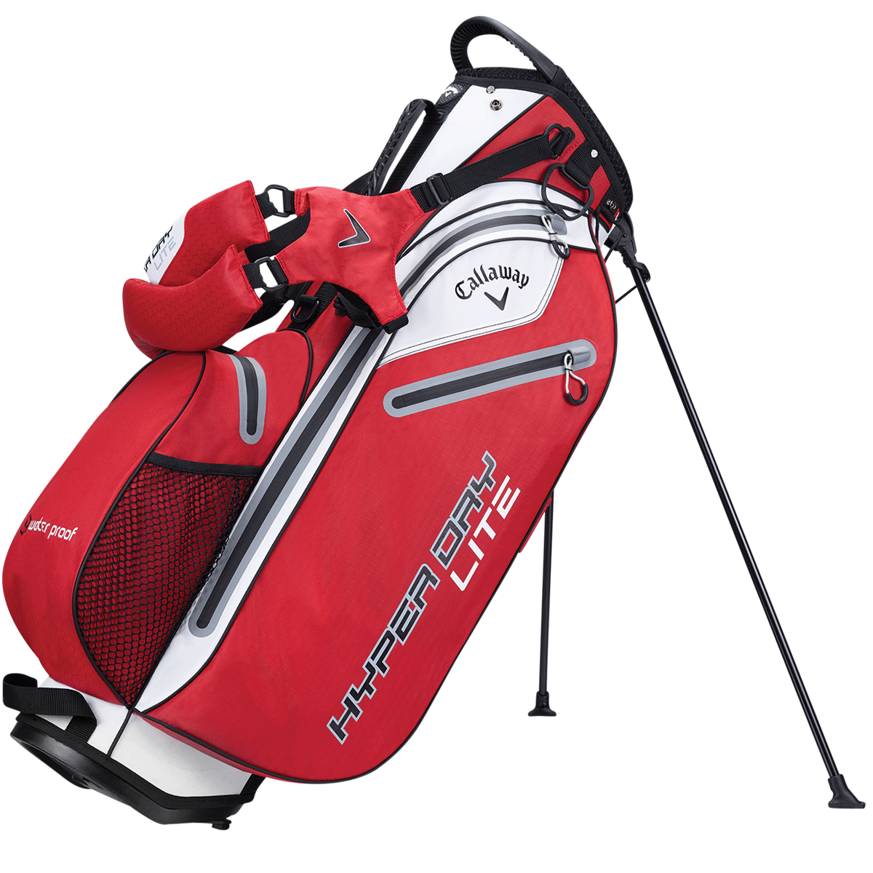
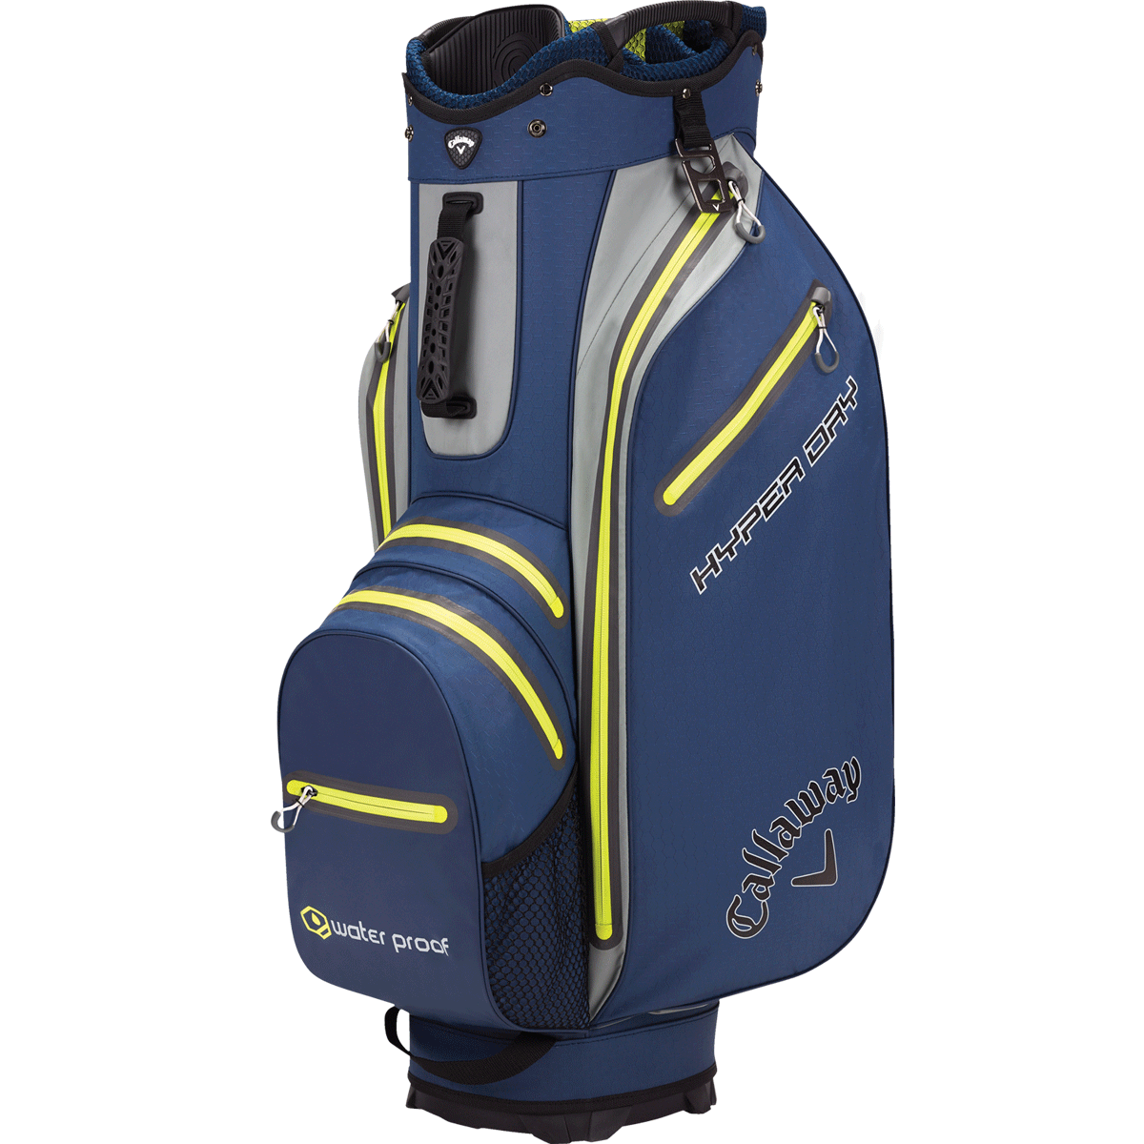
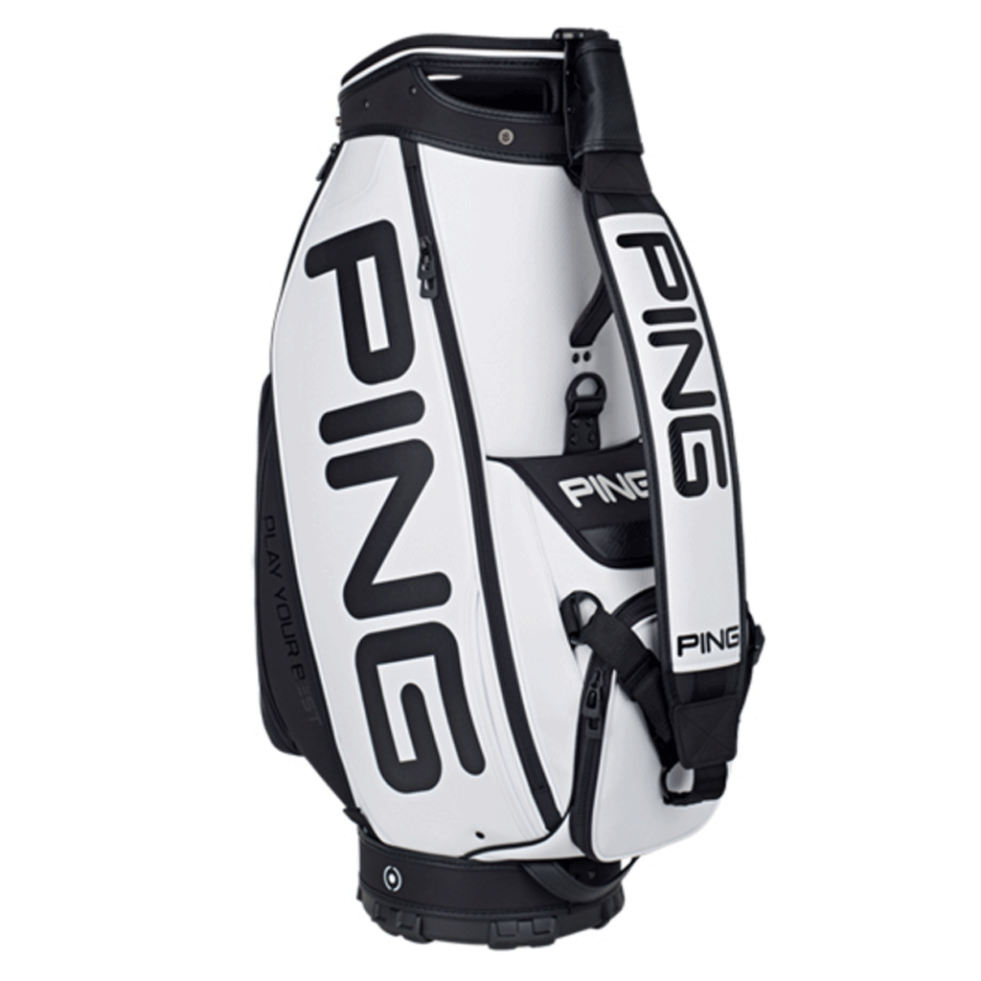
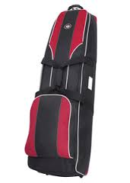
Golf Bag
Nylon, canvas and/or leather, with plastic or metal reinforcement and framing
Carry Bags
  Sunday Bags
  Stand Bags
Cart Bags
Staff Bags
Travel Bags

Slide 16
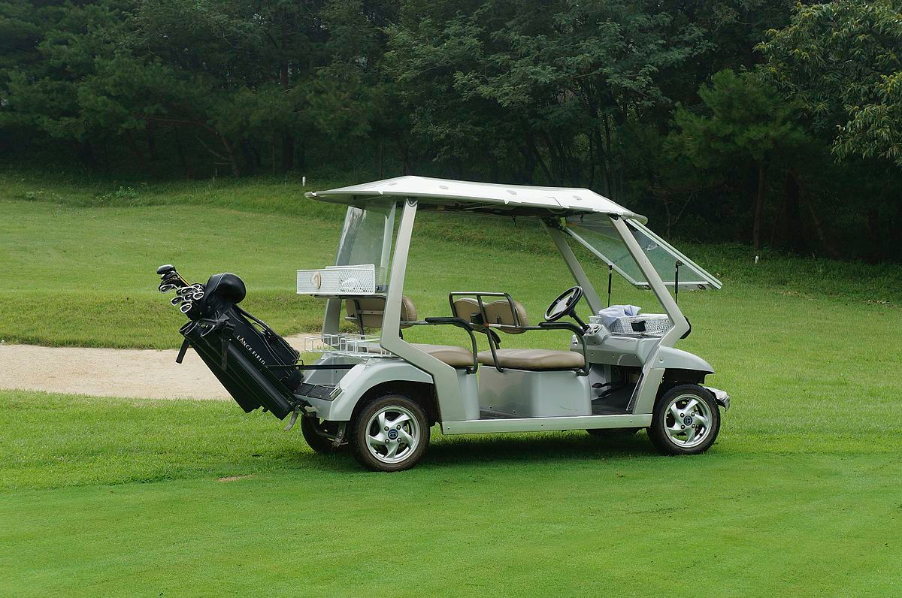
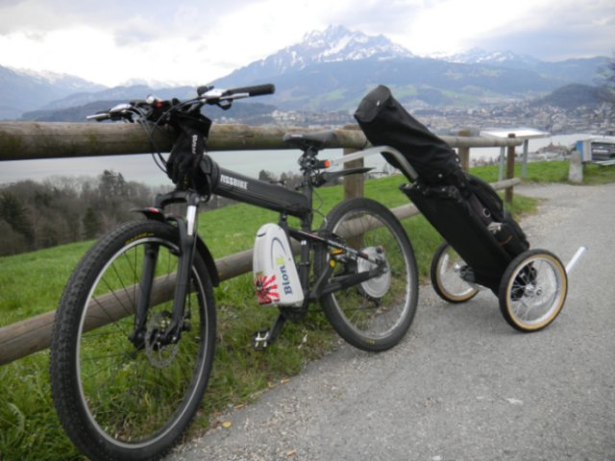
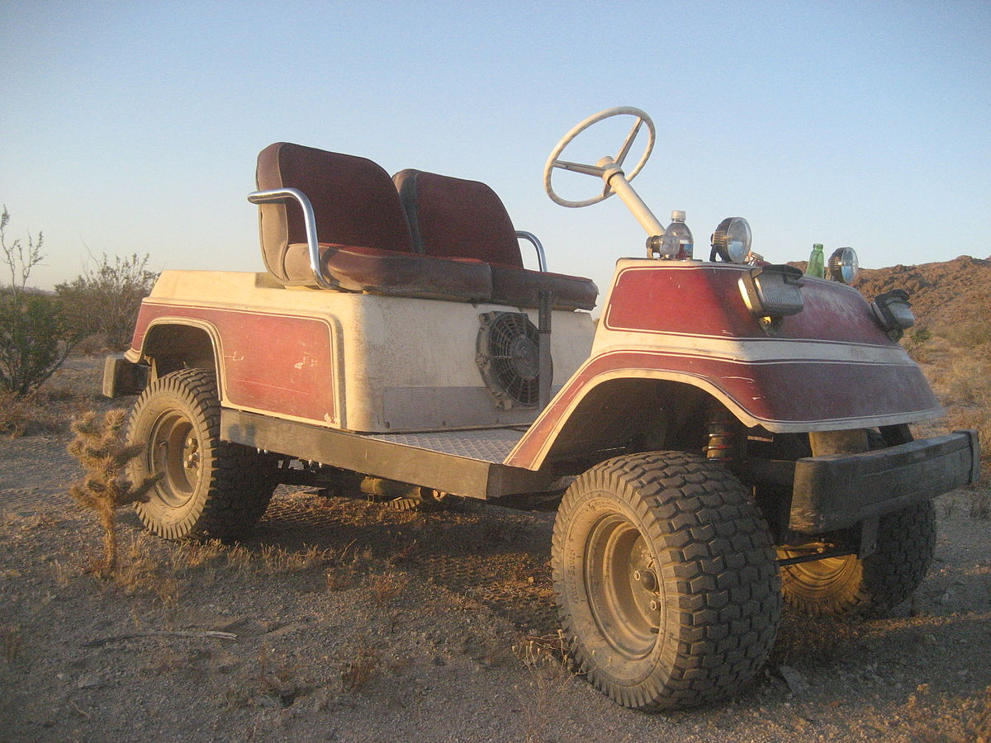
Golf Cart
a small vehicle designed originally to carry two golfers and their golf clubs
speeds less than 15 mph (24 km/h)
under US$1,000 to well over US$20,000
electrically powered, gasoline-powered variants
minimum age to drive a golf cart 13 – 15 years

Slide 17
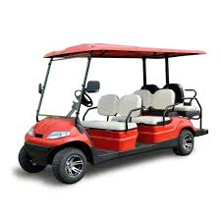

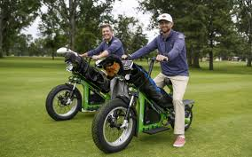

Slide 18

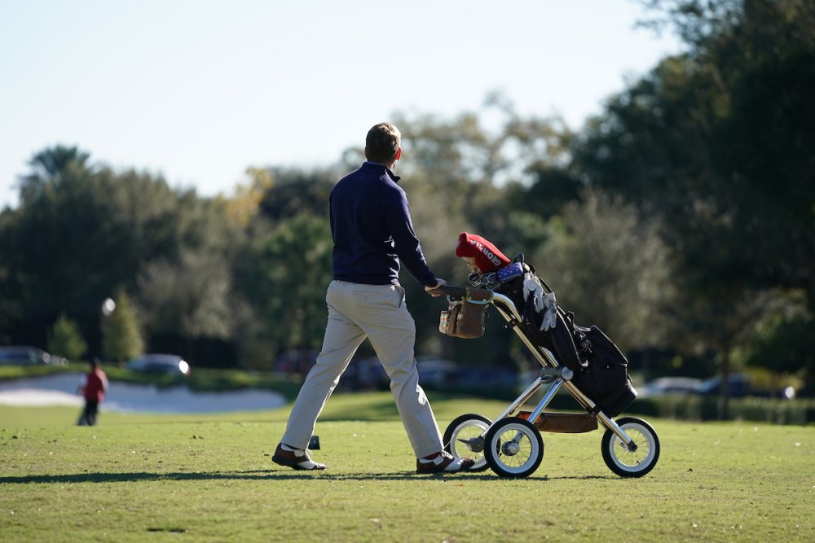


Slide 19
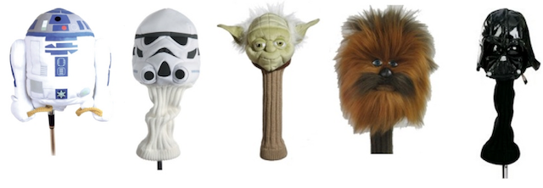
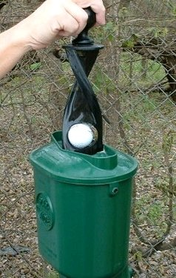
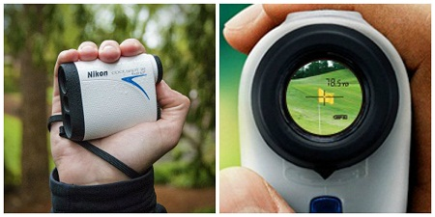
Others
Towel
Club head covers
Ball mark repair tools
Rangefinders
Stroke counters
Positional guides
Ball washers
Golf training aids

Slide 20
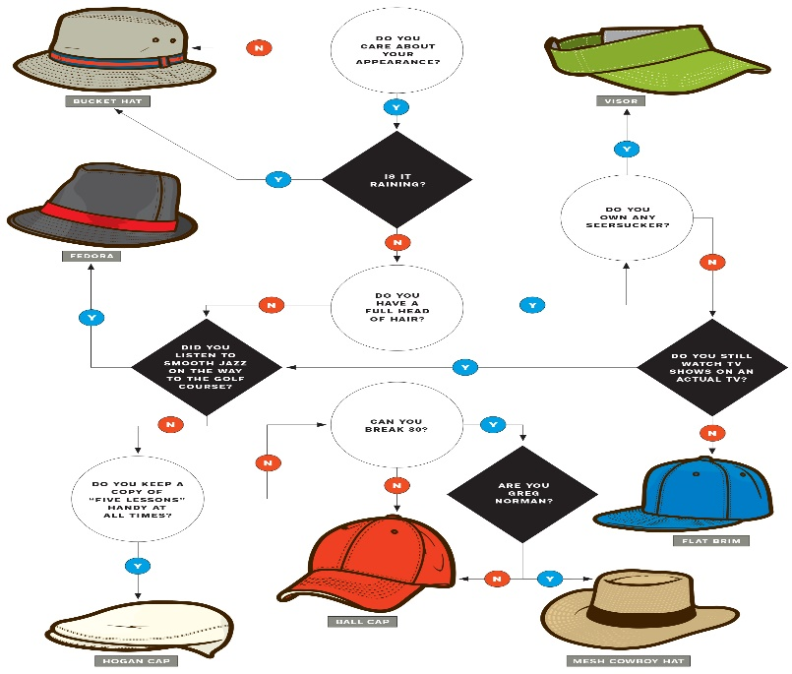
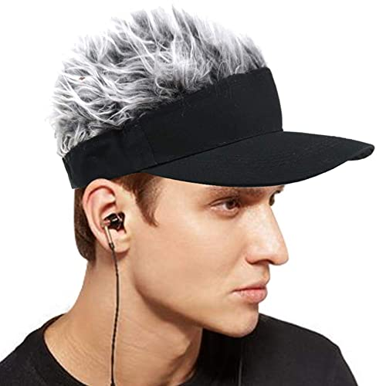

Golf Cap

Slide 21
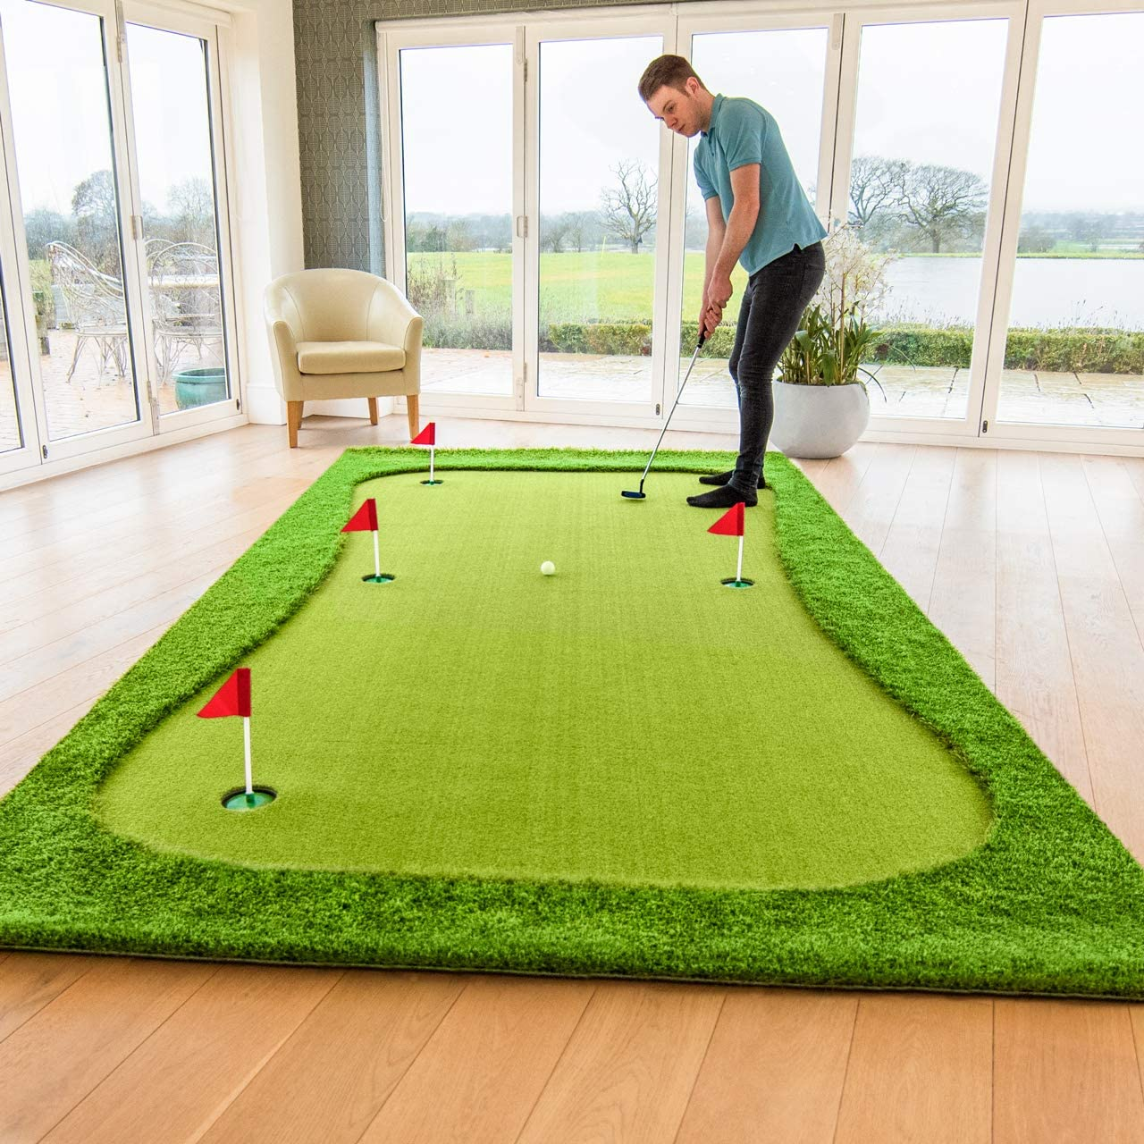
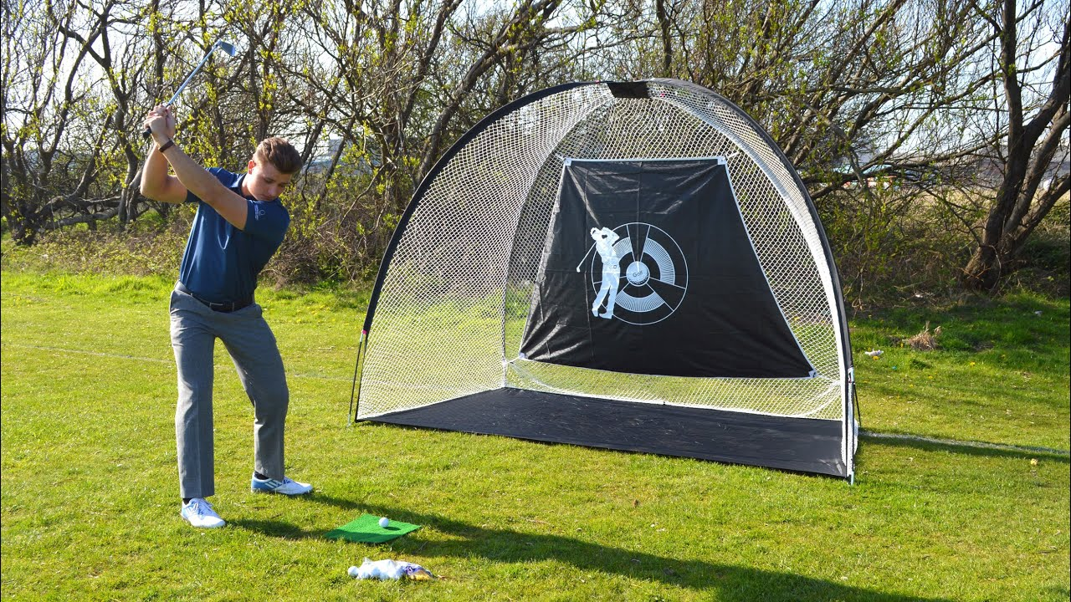
Putting Mat
Golf Driving Net

