Slide 1
GOLF RULES & ETIQUATTE

Slide 2
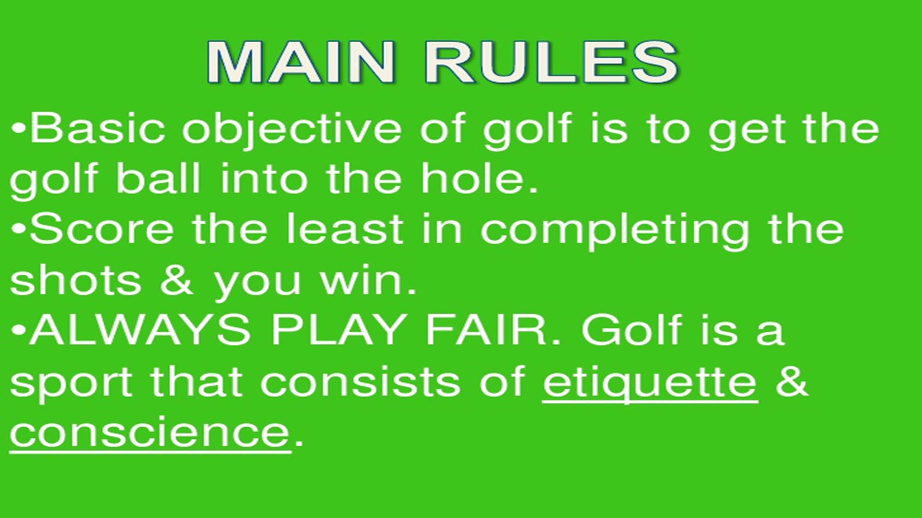

https://www.youtube.com/watch?v=99nN7WWNF1Q
https://www.youtube.com/watch?v=P2Z-KnEKIxk

Slide 3
10 Basic Rules of Golf
1- Etiquette
Be considerate of your fellow players. Don't talk, move, or distract a player in any other way during his swing.
2- 14-club limit
The USGA allows a maximum of 14 clubs to be carried in a bag. Less than that is okay.
3- Tee markers
When teeing off on a hole, the ball must be behind the tee markers. (Draw an imaginary line between the two markers and tee your ball behind that line.)
https://www.youtube.com/watch?v=8POvfyloT3o

Slide 4
10 Basic Rules of Golf
4- As it lies
Play the ball as it lies. This means you may not improve the way the ball is at rest. If you are on the green, you may mark and pick up your ball to clean it, but while in the fairway, you must play the ball as it lies. See the USGA rule book for special circumstances like winter rules, obstructions, standing water, etc. https://www.youtube.com/watch?v=s9JGObPdCFA
5- Away
The ball farthest from the hole is the one that is played first. The term is "away." Example: "John, you are away, so go ahead and play first." The person with the lowest score for the hole has "the honors," and plays first on the next hole.
6- Sand traps
If your ball lands in the sand trap, remember to rake it after you have played your shot. The groups behind you will appreciate this. Since this is a hazard, you cannot ground your club prior to the swing. Practice swings are okay, as long as you do not contact the sand.
https://www.youtube.com/watch?v=ZgVyzlVsZp0

Slide 5
10 Basic Rules of Golf
7- Out of bounds
If you hit your ball OB, there is a one-stroke penalty, and you must hit another ball. If you are not sure if the ball is OB, hit a "Provisional Ball" just in case. If you determine that the first ball is OB, then you continue on and play with the Provisional Ball.https://www.youtube.com/watch?v=An-EqBFa2L8
8- Water hazards
If you hit your ball into a water hazard, you may play it (could be messy), or play another ball from where you just hit (with a one-stroke penalty). Another option is to drop another ball where the original ball entered the hazard, incur a one-stroke penalty and play on.https://www.youtube.com/watch?v=5Puxb51tenM
9- Putting green
When on the green, never walk across another player's line of putt. The imprint that your feet leave on the green can alter the path of the ball. Always step over the line of the putt or around it. https://www.youtube.com/watch?v=kMxfdo282PM&t=446s
10- Have fun
Golf is a great game, so have fun with it and whenever possible, leave the golf course in the same shape that you found it.

Slide 6


Slide 7


Slide 8
More Golf Etiquette Hints
• Quiet, please! Never talk during another player's swing.
• Do not yell out following a shot. Even if boisterous behavior doesn't bother your playing partners, there are other people on the course who may be within earshot.
• Be aware of your shadow on the putting green. Don't stand in a place that causes your shadow to be cast across another player or that player's putting line.
• Never walk through a playing partner's putting line. Your footprints might alter the path of a partner's putt. Step over the putting line, or walk around (behind) the partner's ball.

Slide 9
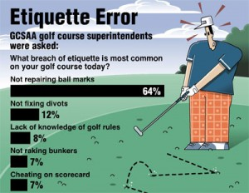



Slide 10
Safety
Do not swing your club until you know that others in your group are at a safe distance. Likewise, keep your distance when others are swinging. Be aware to steer clear of trouble.
When practicing your swing, never swing in the direction of another player. There may be pebbles or twigs or other matter in the grass that could fly up and injure a playing partner.

Slide 11
Safety
If your ball appears headed toward another player or another group, give them a warning by yelling out, "Fore!"https://www.youtube.com/watch?v=OhprqTw7Biw
https://www.youtube.com/watch?v=XXYpMWSsHKU

Slide 12
Safety
Never throw clubs in anger. In addition to being rude and childish, it could also be dangerous.
https://www.youtube.com/watch?v=WmlUwAcDhcA
https://www.youtube.com/watch?v=KeJ6nmxc_WI

Slide 13
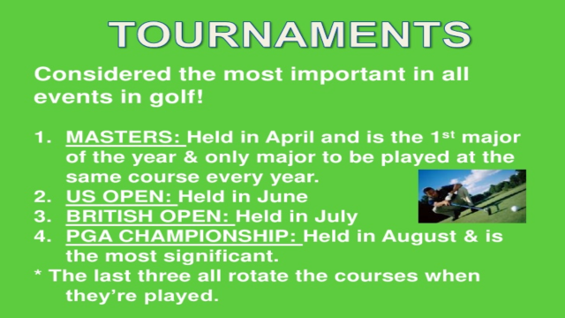

Slide 14


Slide 15
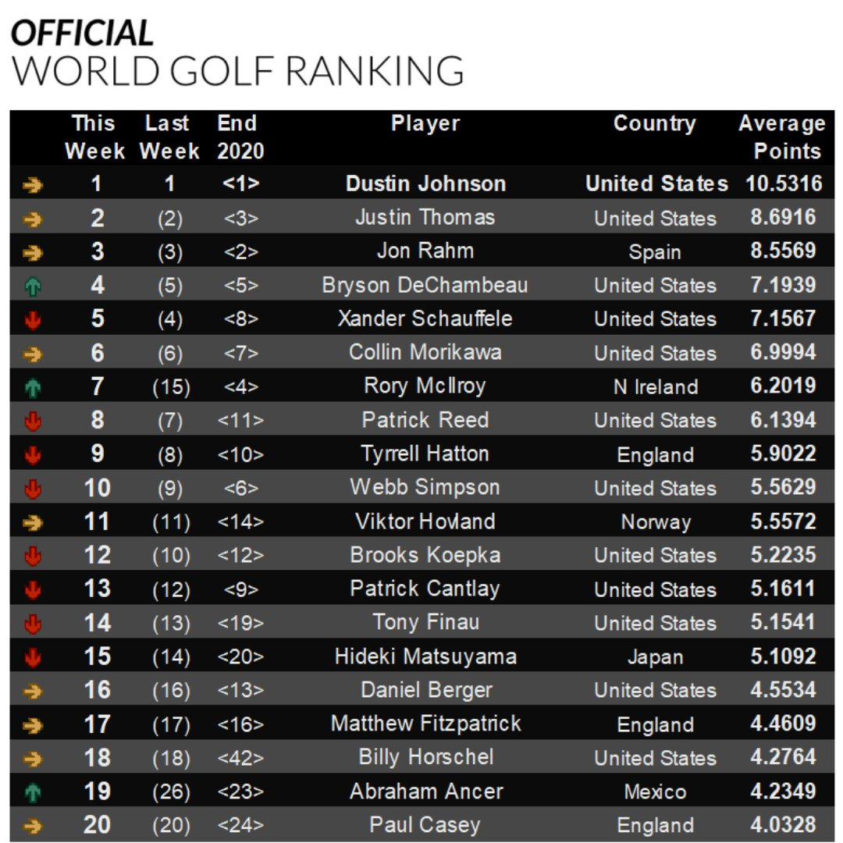
https://www.youtube.com/watch?v=_7Ng4l7Jv_I

Slide 16


WOLRD GOLF RANKING LADIES
https://www.rolexrankings.com/

Slide 17
Golf Scoring
Start with par, because all golf scoring terms are defined in relation to par. "Par" refers to the number of strokes an expert golfer is expected to need to complete the play of one hole on the course.

Slide 18
Golf Scoring
Assume that you are playing on a hole that has a par of 5.
Eagle: On a par-5, means you finished the
hole in 3 strokes
Birdie: You finished the hole in 4 strokes
Par: You finished the hole in 5 strokes

Slide 19
Golf Scoring
Bogey: You finished the hole in 6 strokes
Double bogey: You finished the hole in 7 strokes
Triple bogey: You finished the hole in 8 strokes

Slide 20
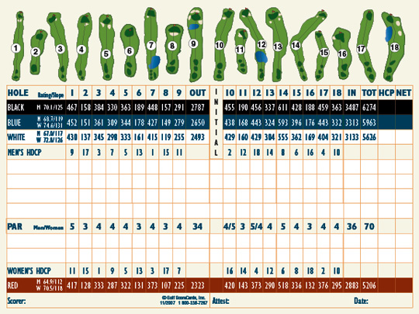
SCORECARD

Slide 21
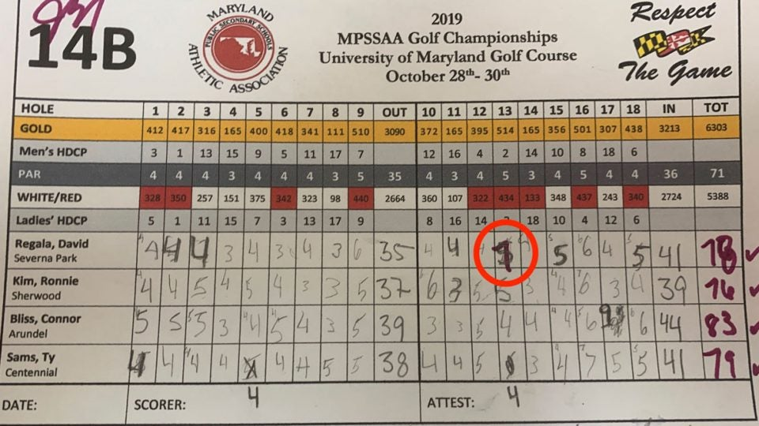

Slide 22
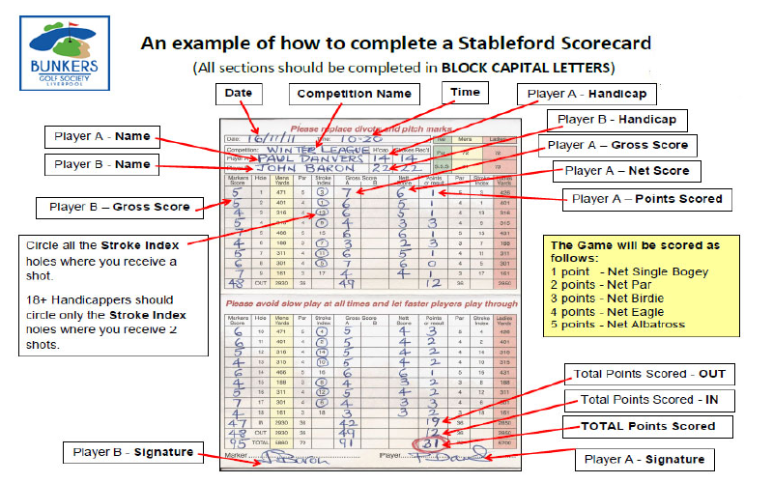

Slide 23
Golf Format Of Play
Strokes Play (Gross & Nett)
In stroke play, every player (or team) competes all 18 holes and counts the total number of strokes and the party with the lower total nett score (gross score minus handicap) wins.
Match Play
In match play, two players (or two teams) play every hole as a separate contest against each other. The party with the lower score wins that hole, regardless of how many shots he won the hole by. If the scores of both players or teams are equal the hole is “halved” (drawn). The game is won by that party that wins more holes than the other. Matchplay is a very popular form of competition at club level.

Slide 24
Golf Format Of Play
Foursome
is played between two players in partnership, playing one ball which they hit alternately. One player tees off on the odd numbered holes, the other on the even holes, regardless of who played the last putt on the first hole. The other shots are played in turns until the hole is finished
Stableford:
Form of strokeplay where the scoring is made by points awarded in relation to a fixed xcore at each hole as follows:
Hole Played In Points
<1 over fixed score —> 0
1 over fixed score —> 1
Fixed score —> 2
1 under fixed score —> 3
2 under fixed score —> 4
3 under fixed score —> 5
4 under fixed score —> 6

Slide 25
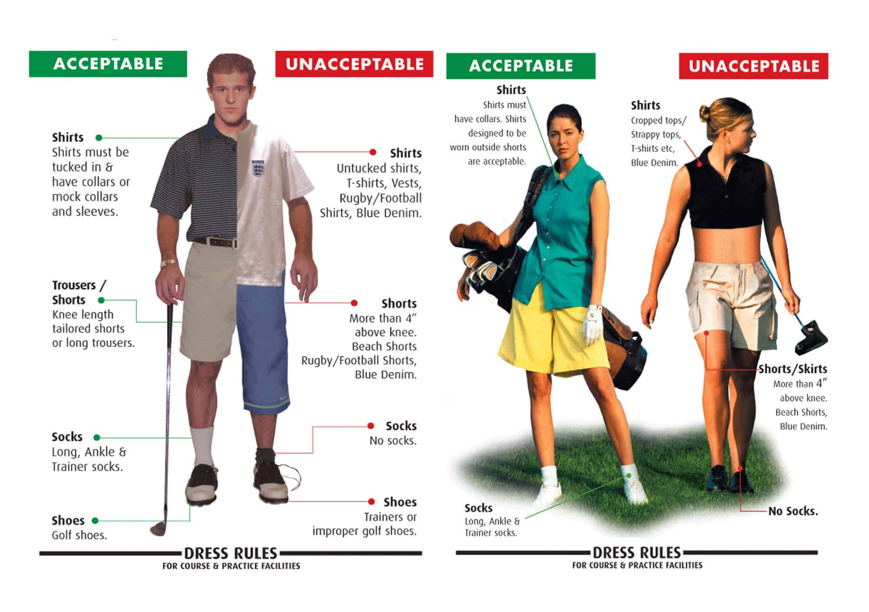
Golf Attire

Slide 26
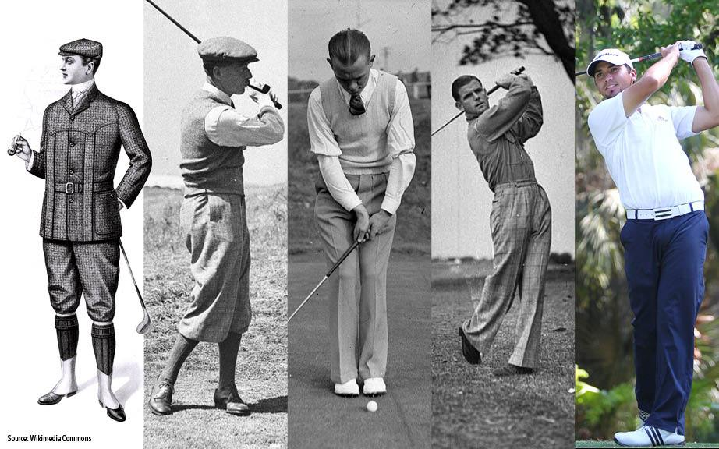

Slide 27
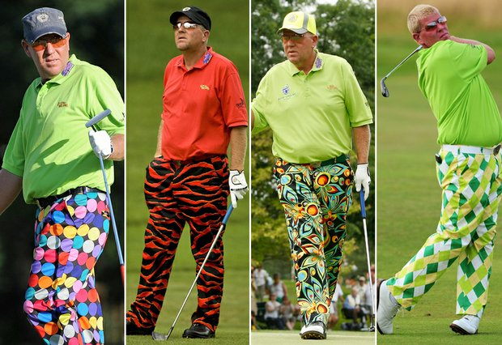

Slide 28
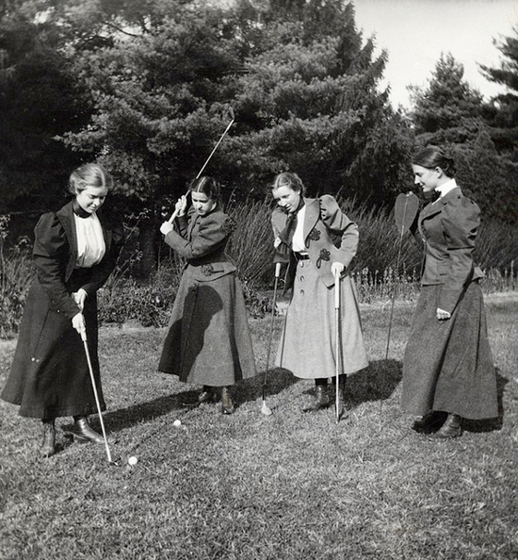

Slide 29


